Slide 1
SDG 10 Inequality Ideas
Note: All here is circa 2015 (defined as the closest data point to 2015, and not more than 5 years away)

Slide 2
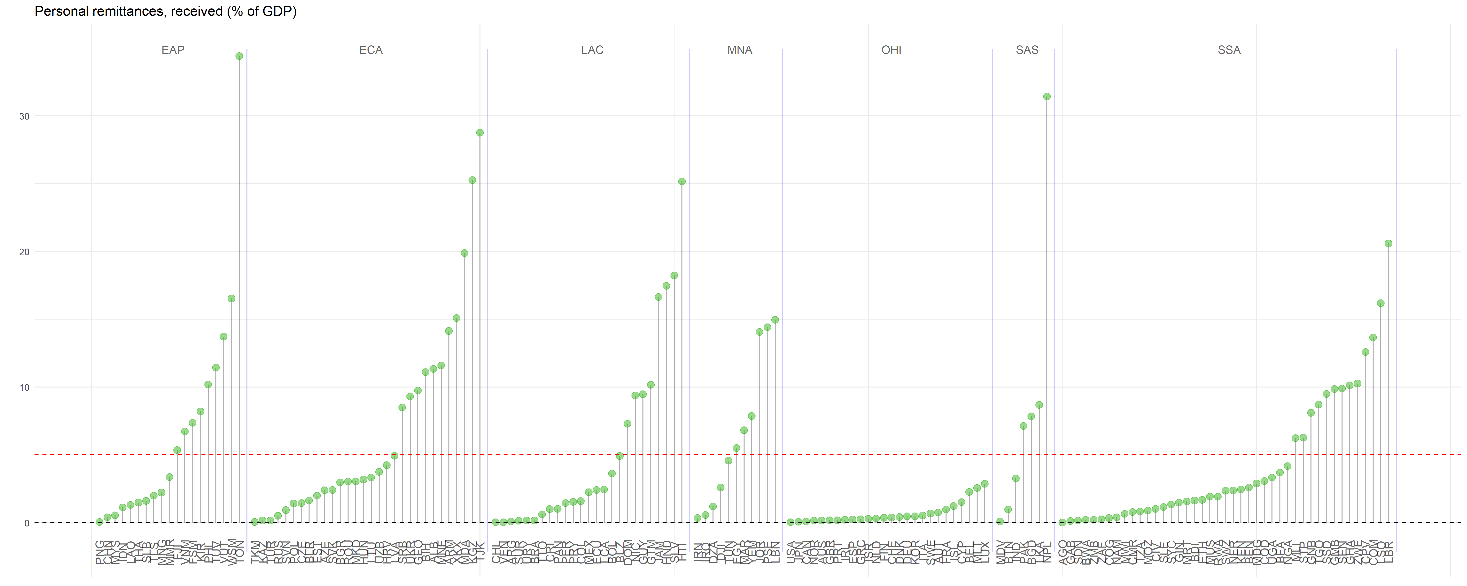
Remittances constitutes a large portion of GDP in many nations. Including some of the most vulnerable as HTI and many SSA nations. This makes of outer importance the goal 10.c intending to keep remittances cost low.

Slide 3
10.3 Ensure equal opportunity and reduce inequalities of outcome, including by eliminating discriminatory laws, policies and practices and promoting appropriate legislation, policies and action in this regard

Slide 4
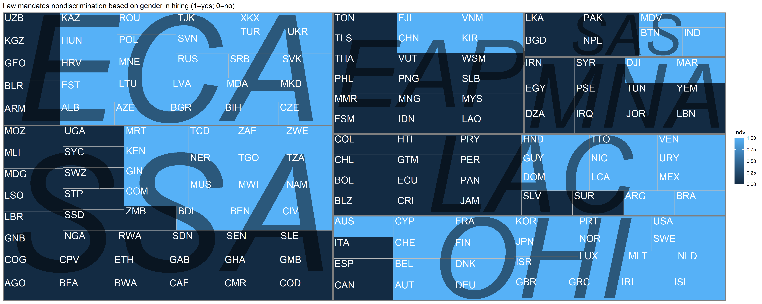
An overwhelming portion of countries still not have a gender non-discriminatory hiring law

Slide 5
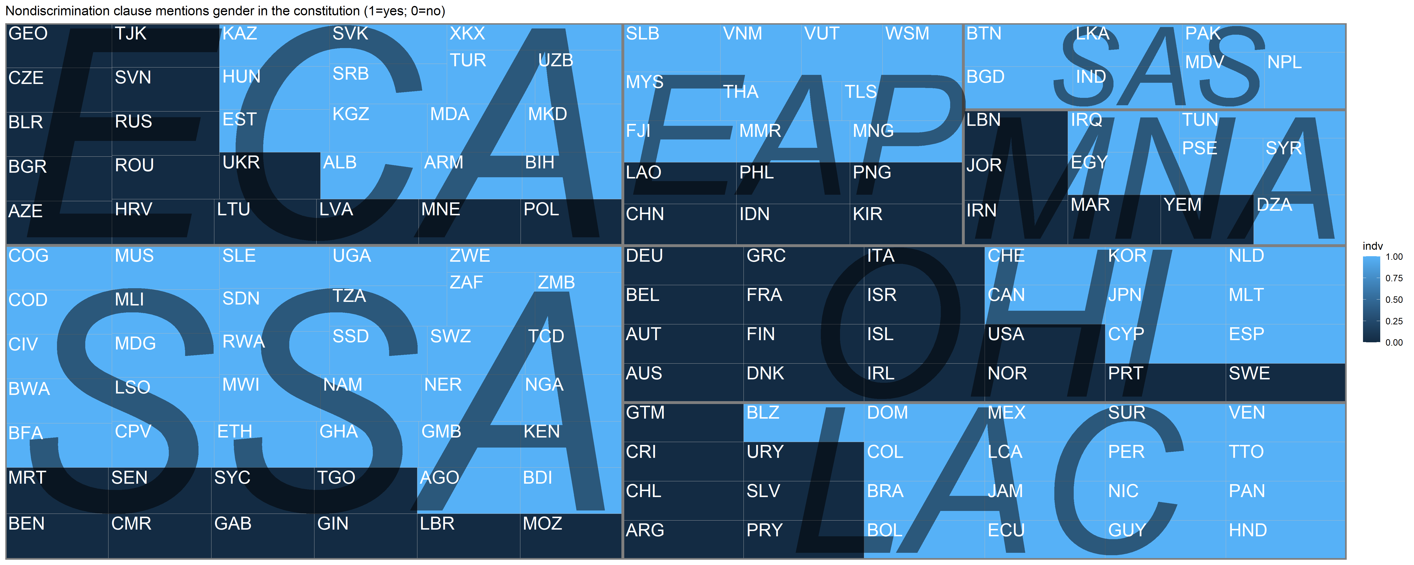
Even if some mention gender discrimination in their constitution.

Slide 6
10.4 Adopt policies, especially fiscal, wage and social protection policies, and progressively achieve greater equality

Slide 7
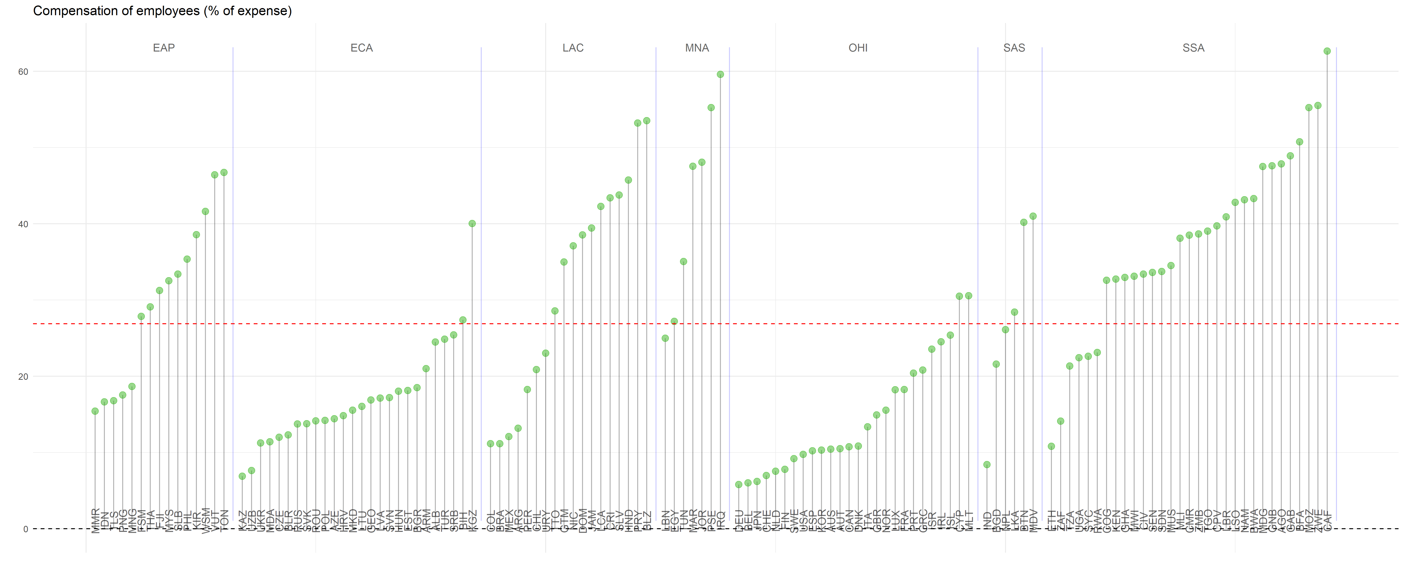
In many countries in SSA, EAP, LAC and MNA the employees compensation constitute a large portion of the expending.

Slide 8
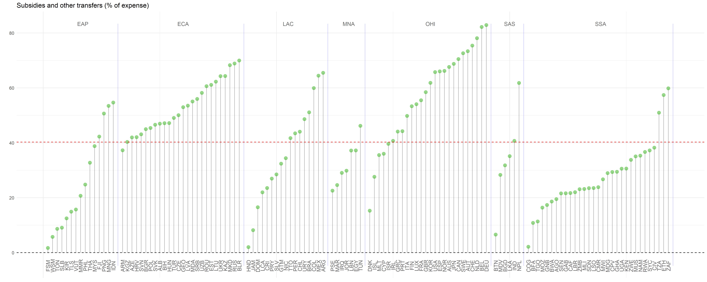
Opposed to that, in the same regions, especially, in SSA very little is going to subsidies and transfers.
While OHI spends less on compensating employees and more on subsides and transfers.

Slide 9
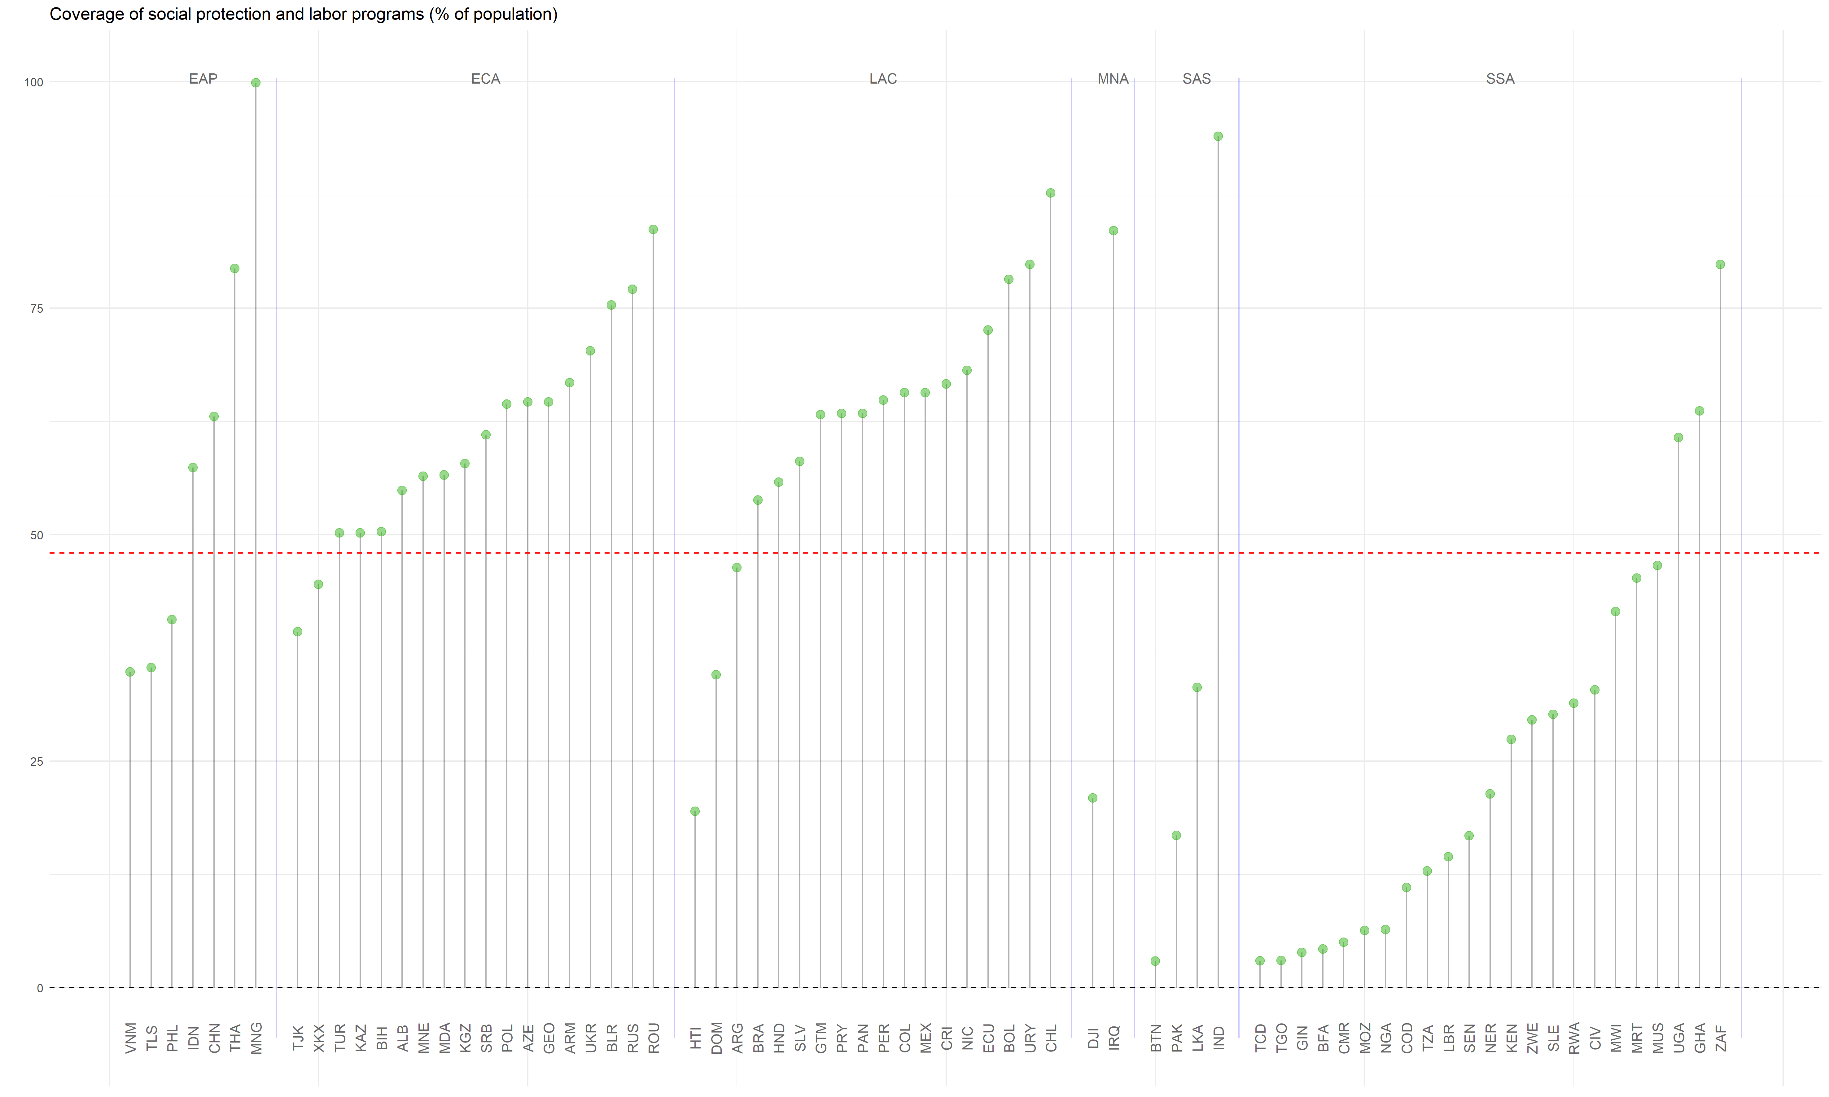
In the same line, social protection seems lacking in SSA.
On the bright side, LAC and ECA have developed systems of social protection that covers a substantial population.

Slide 10
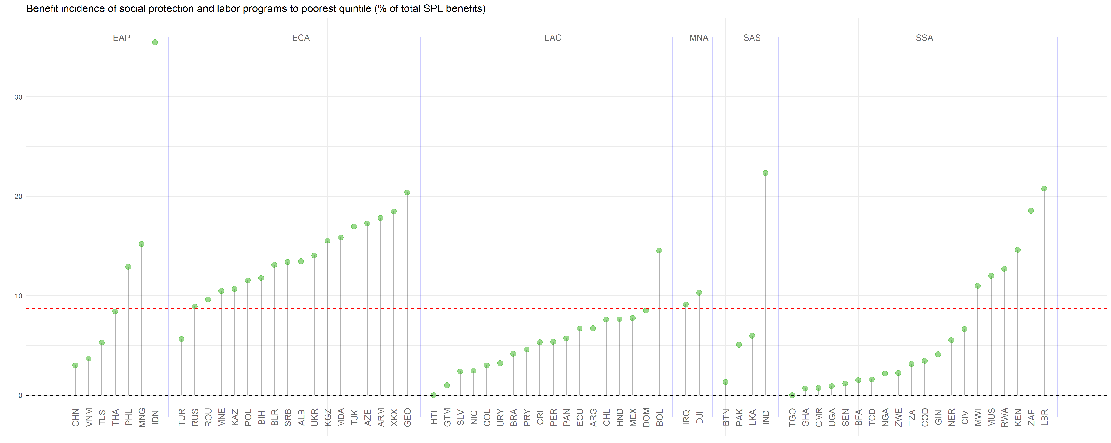
Sadly, even in regions as LAC where high coverage exist the incidence of social programs among the poorest population is low.

Slide 11
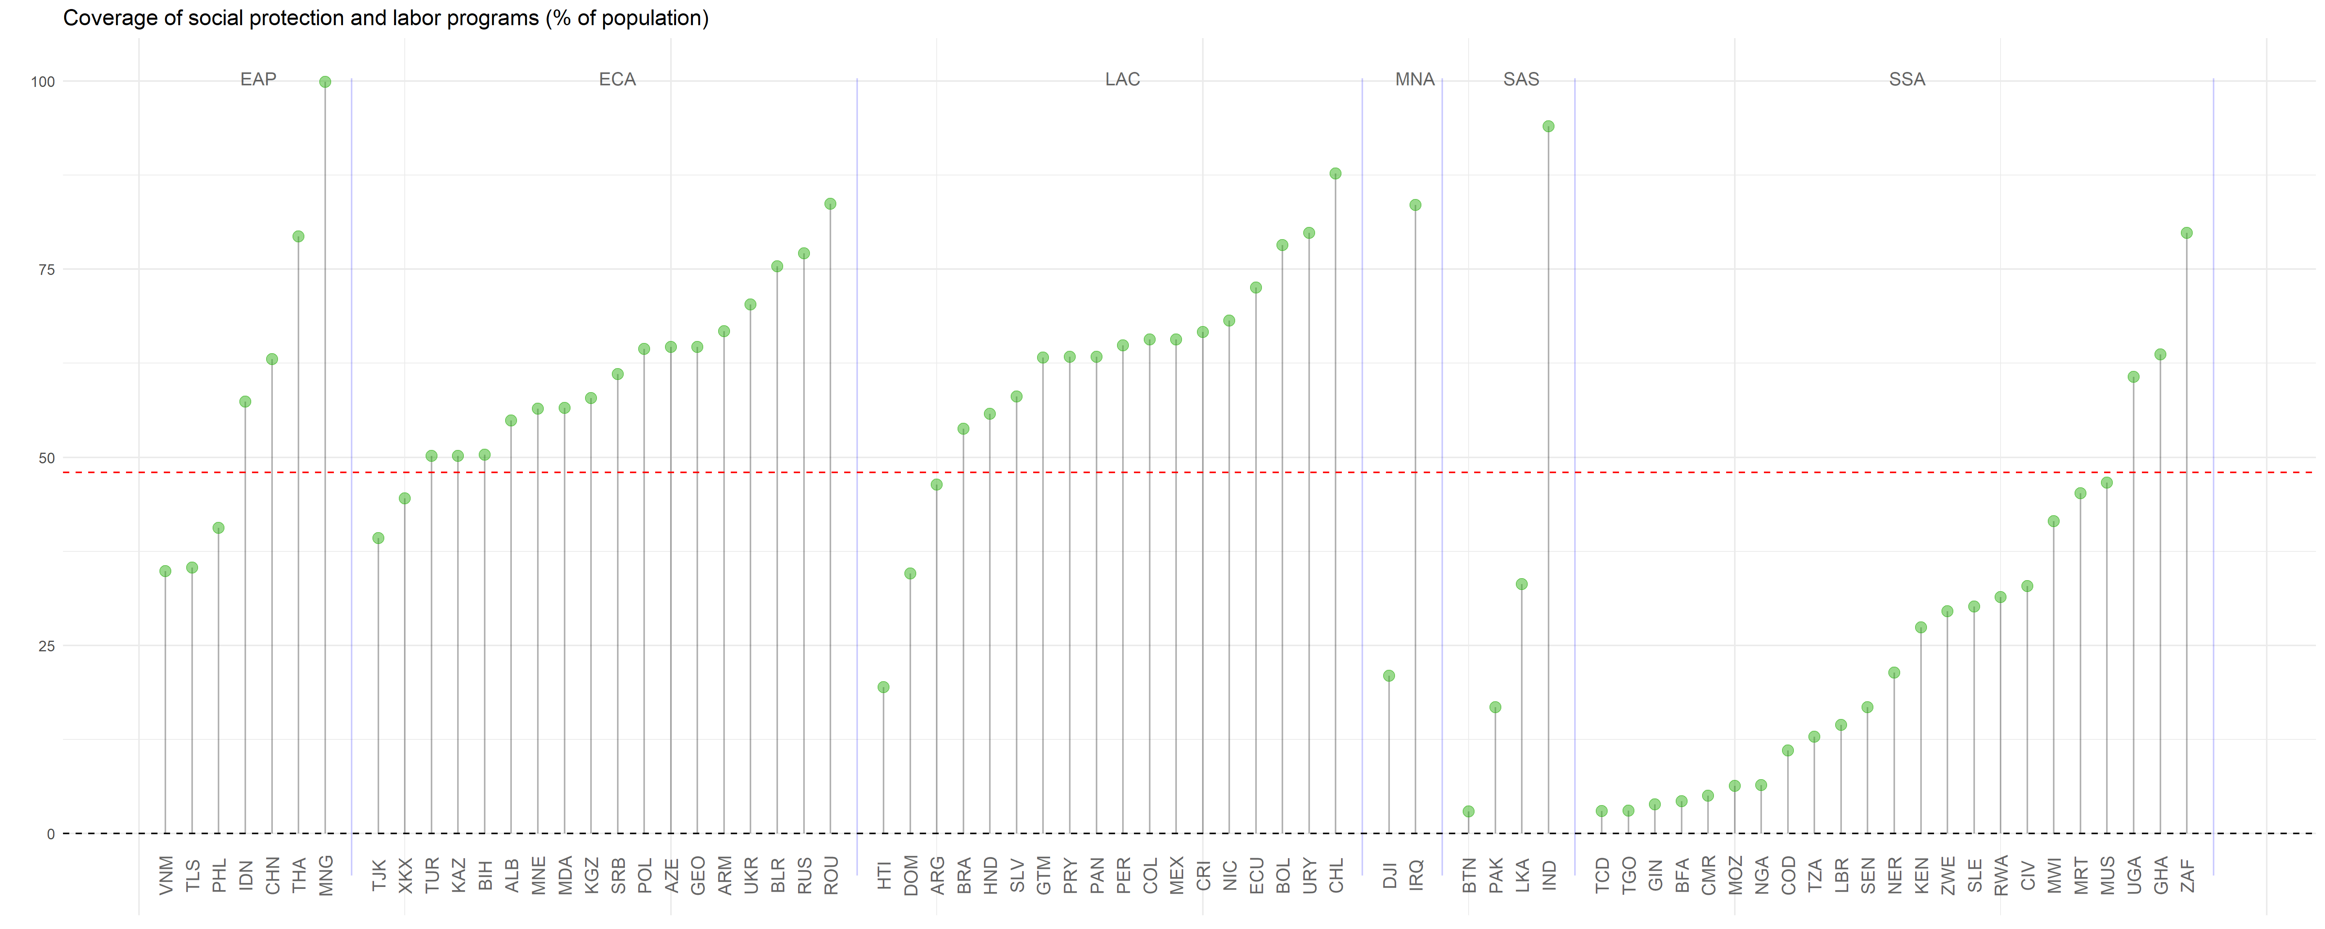
Programs of social protection and labor programs are covering an important share of the population. However this not the case for SSA.

Slide 12
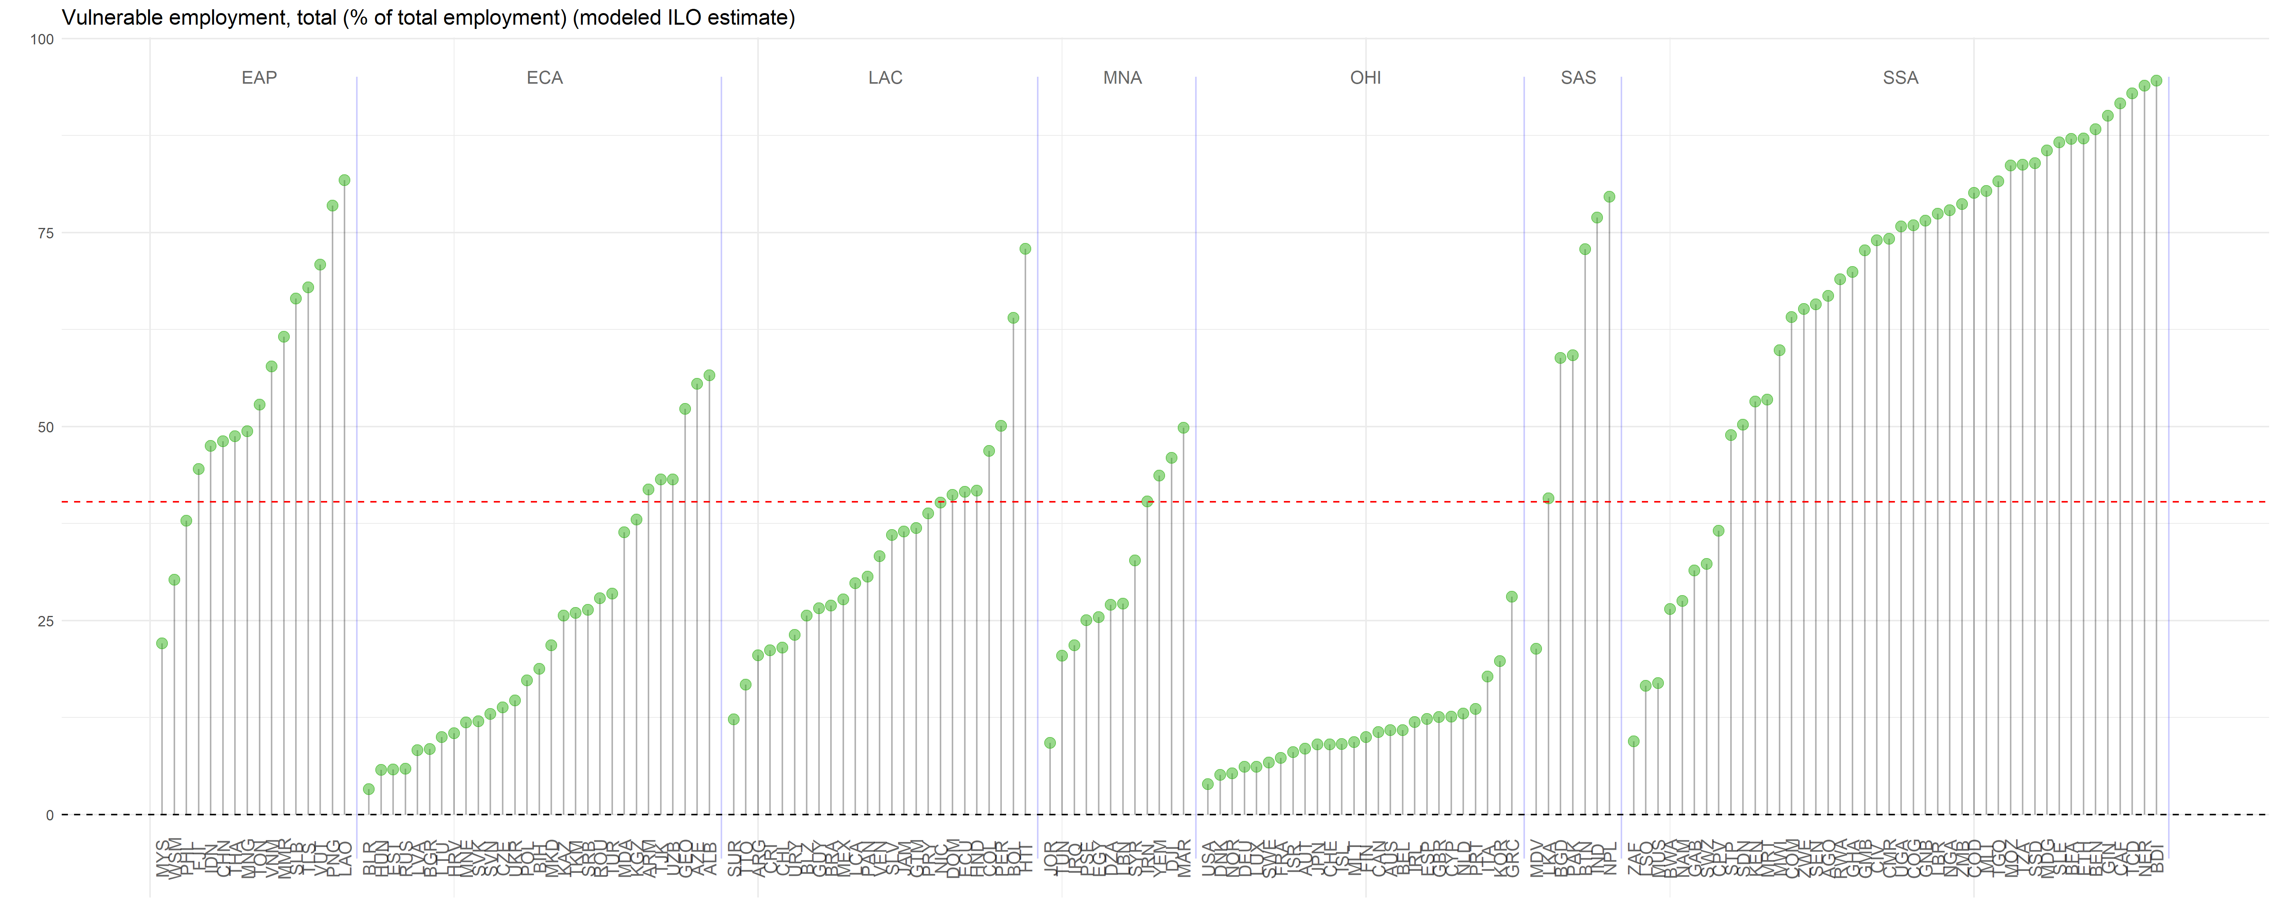
This is worrying as in most of the SSA’s nations a large portion of the population have a vulnerable employment condition. Moreover, worldwide there’s a large share of people in such situation.

Slide 13
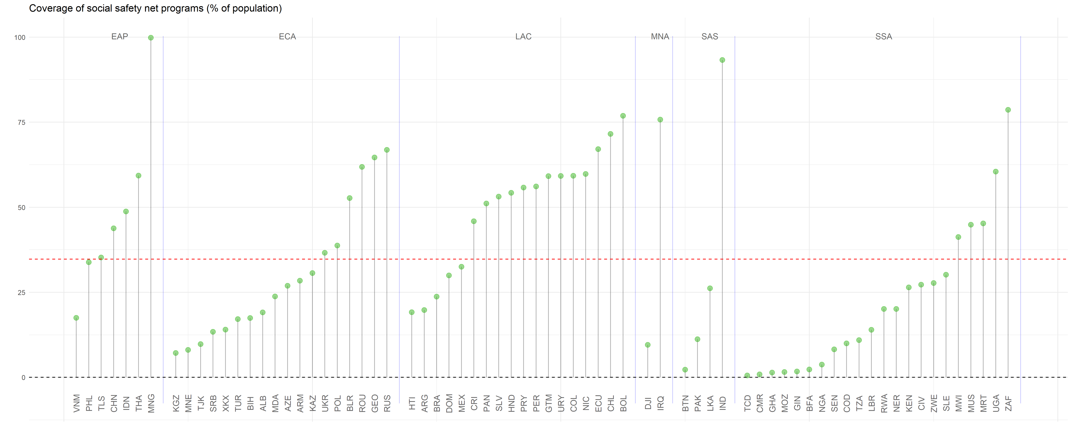
Safety nets are crucial to achieve equality of opportunity. Regions as LAC have a large share of their population under a safety net, however regions as SSA do not.

Slide 14
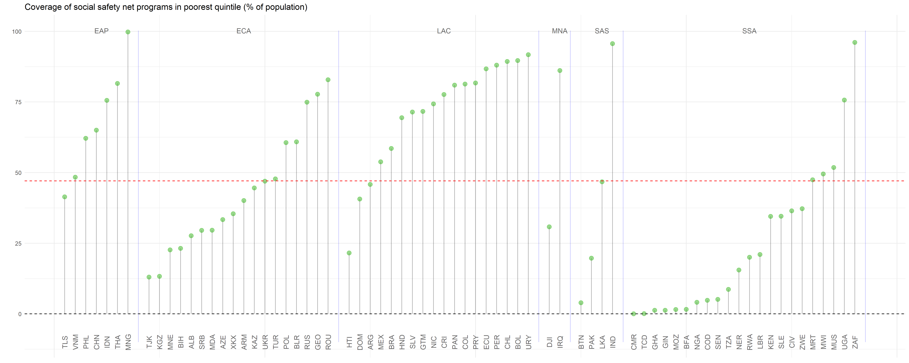
The same holds if we take into account only the poorest.

Slide 15
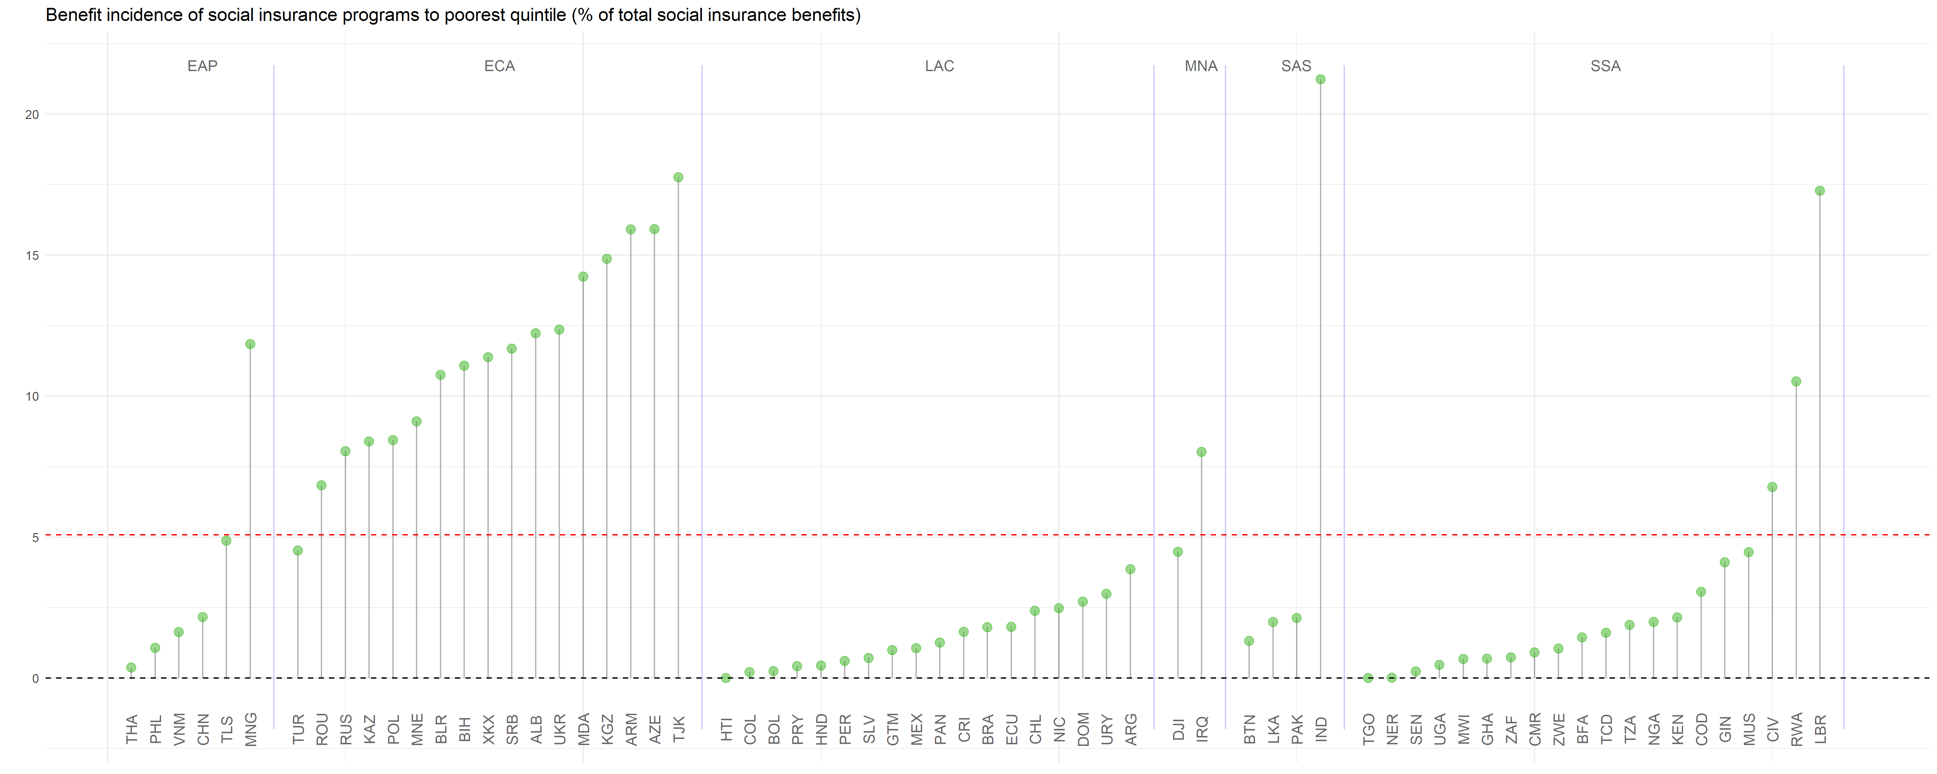
Social insurance is key to level opportunities, however the incidence of such programs to the poorest is relatively low.

Slide 16
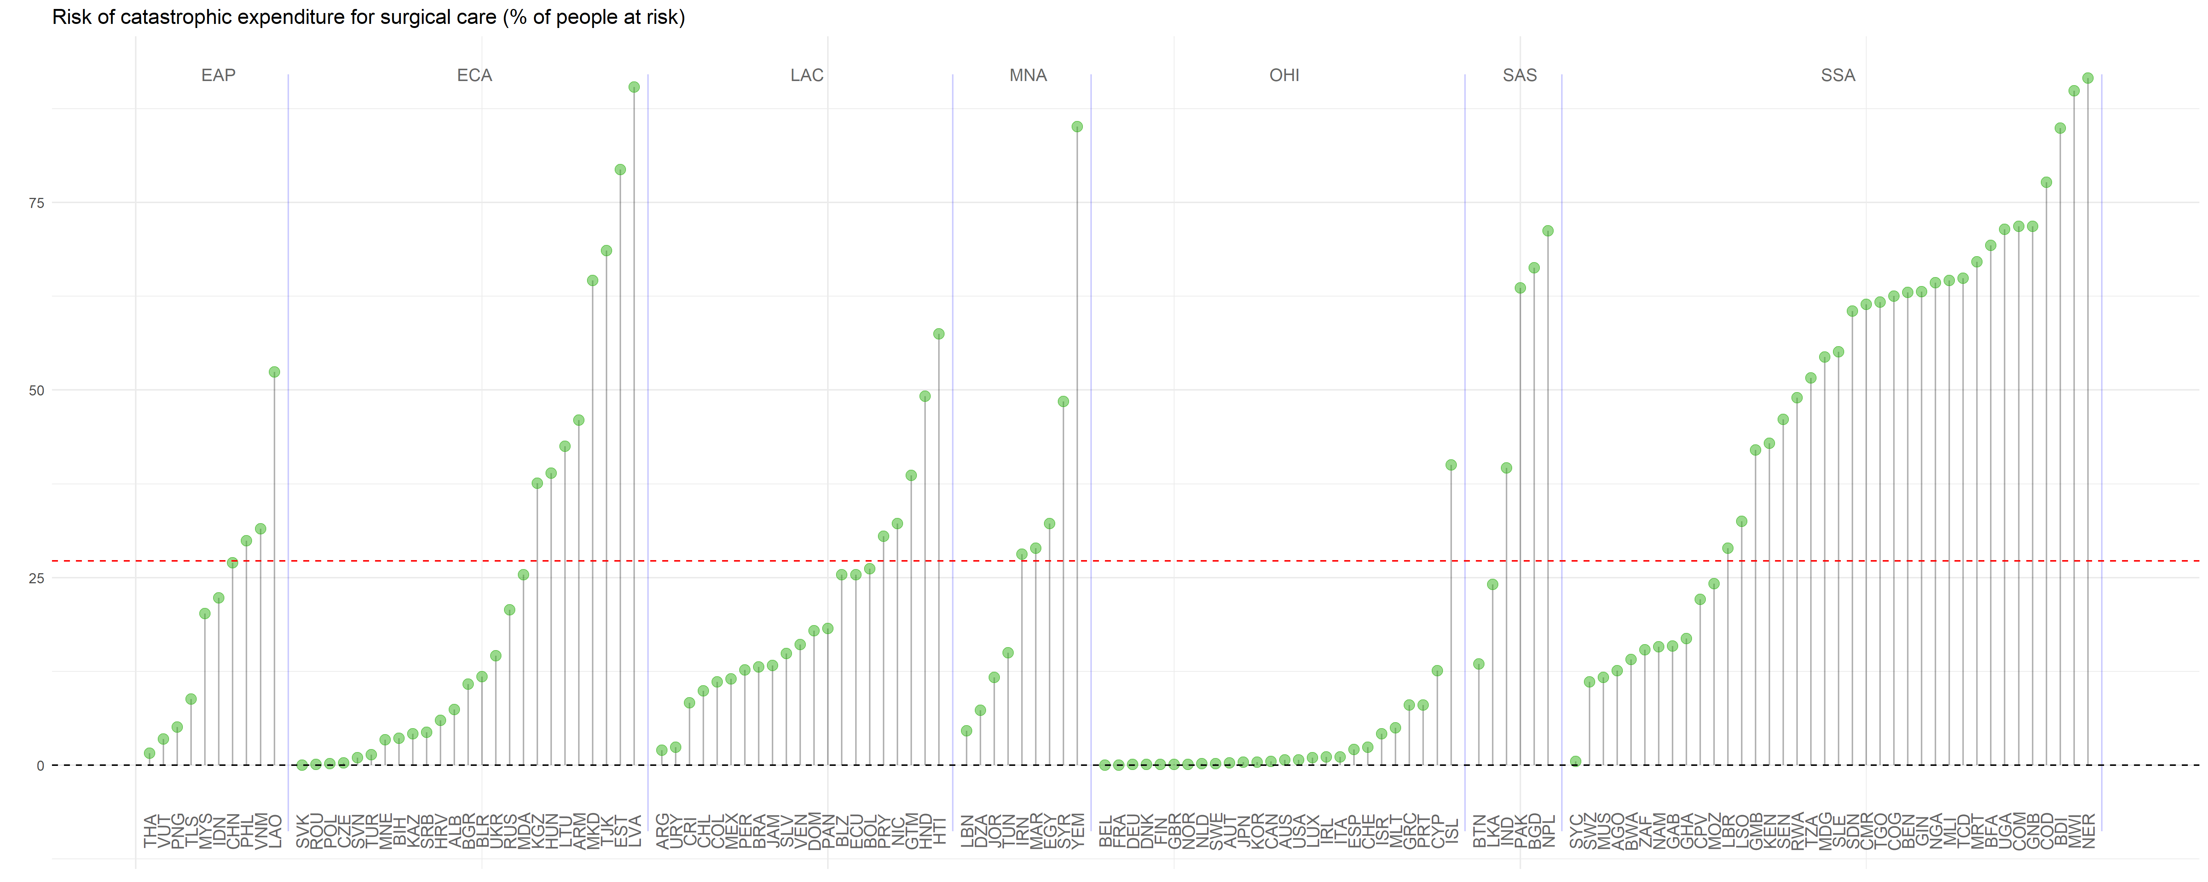
An a lot of people are in risk, for example of the risk of catastrophic health expenditure is high, more so in the SSA countries.

